Slide 1
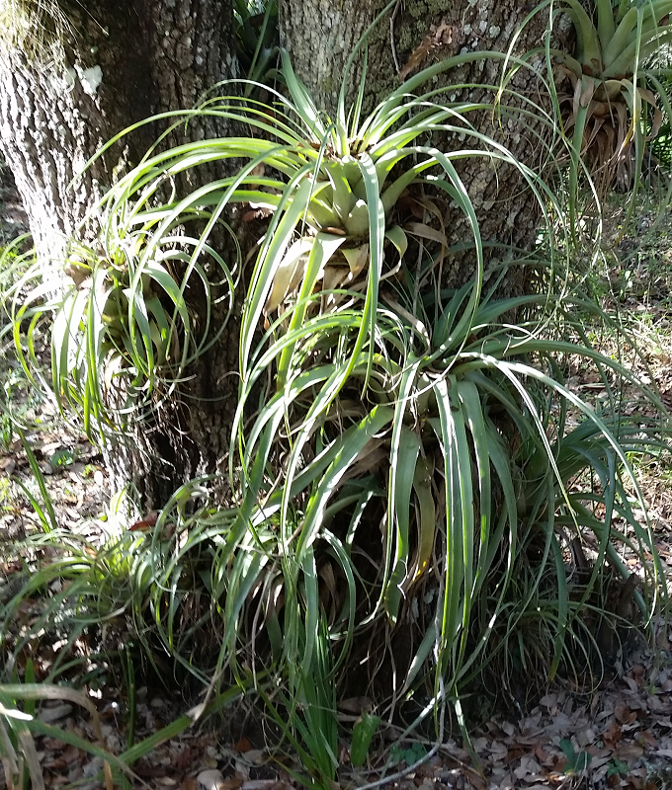
GAP December 2015
Saving the Giant Airplant in Florida
Teresa M. Cooper PhD, University of Florida

Slide 2
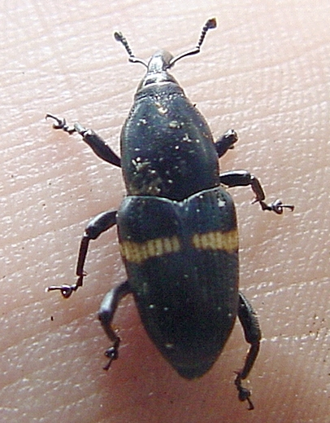
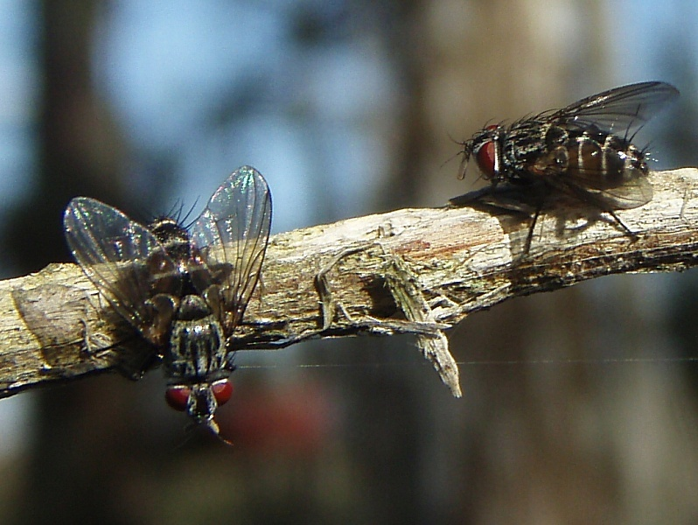
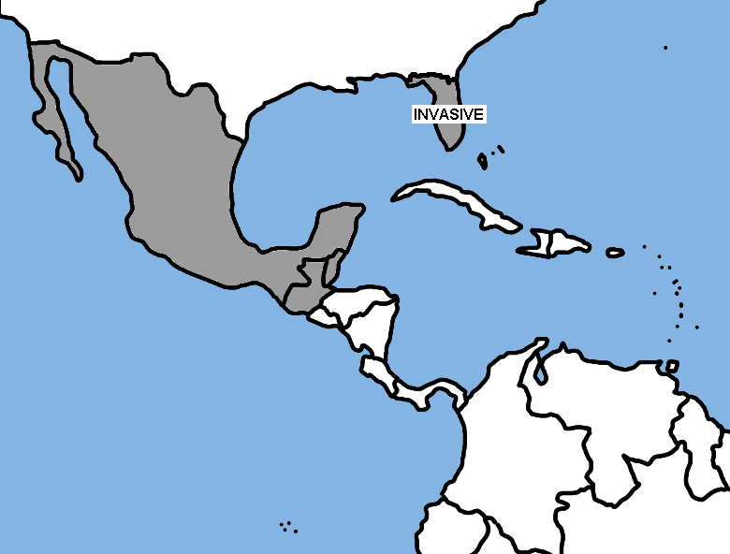
Mexican bromeliad weevil
1.0 – 1.5 cm long, black with stripe across elytra.
Arrived in Florida on ornamental bromeliads shipped from Mexico to Florida.
1989: Found already established on native Tillandsia populations in Broward county. It was too late to eradicate the weevil.
Attempted classical biological control solution; not successful.
Now: Conservation
while we look for
other solutions.

Slide 3
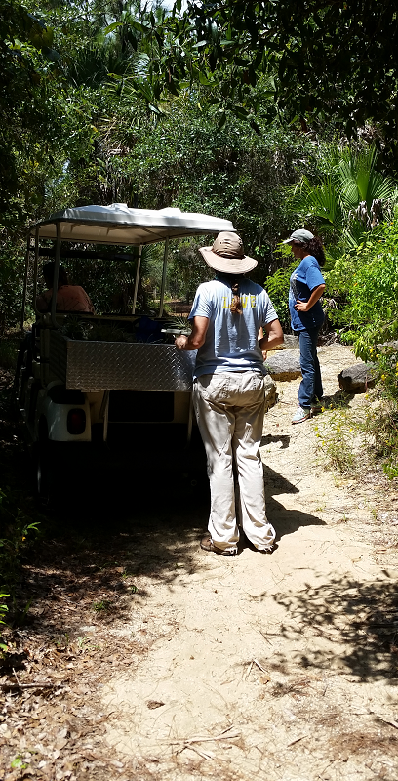
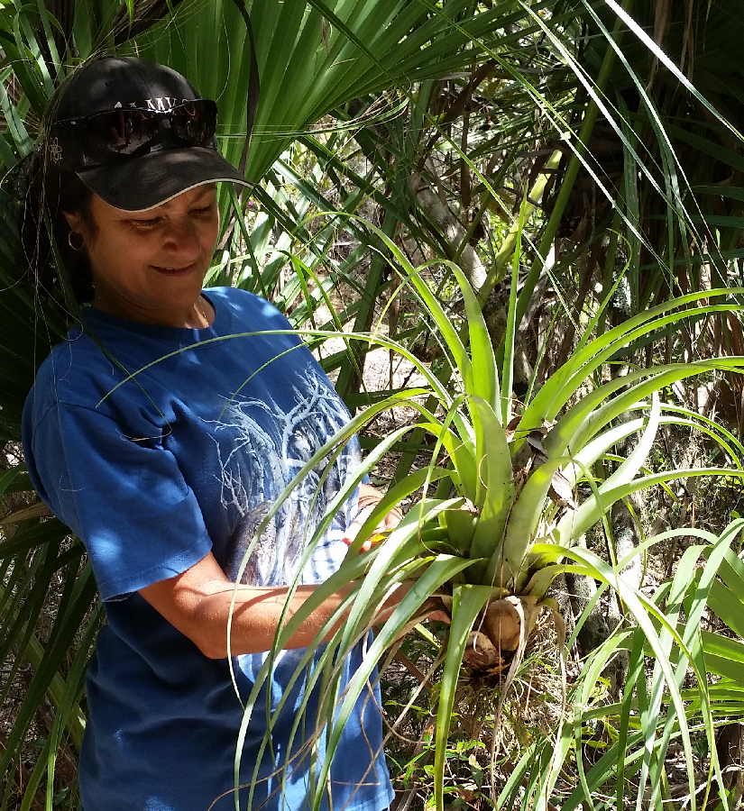
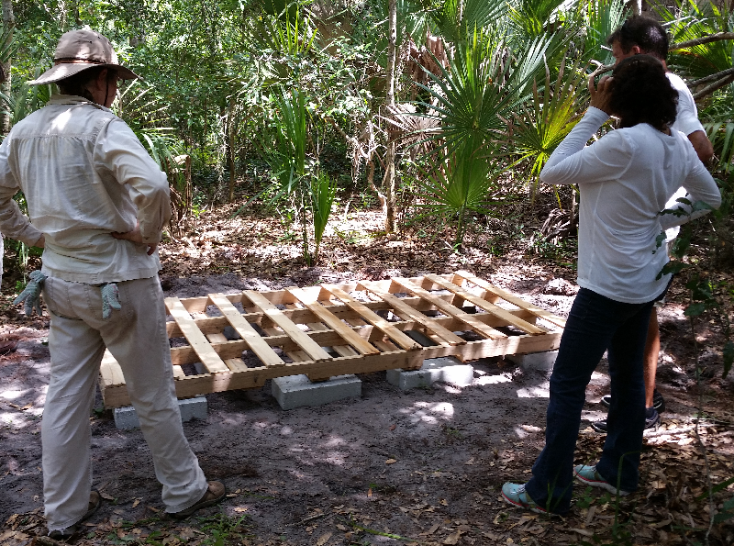
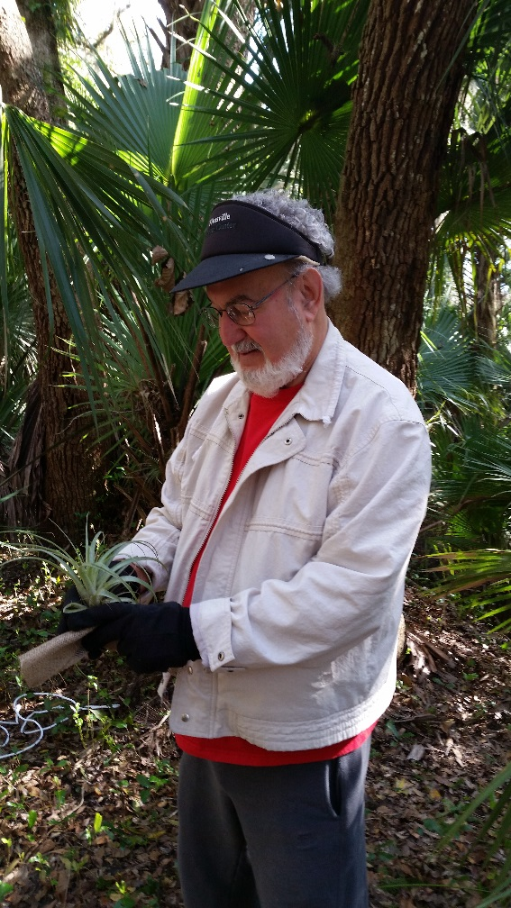
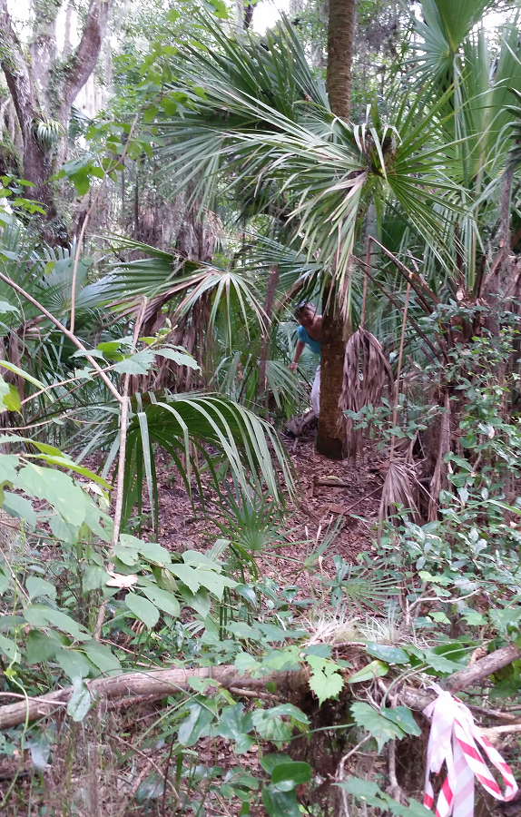
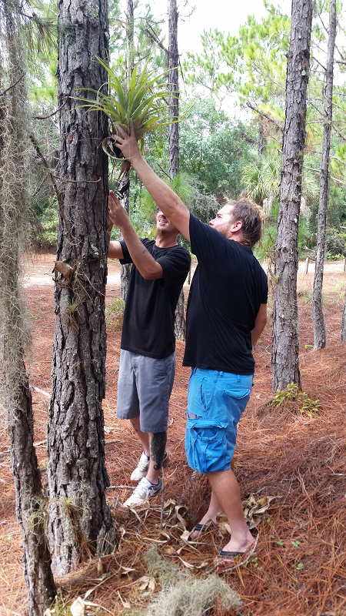
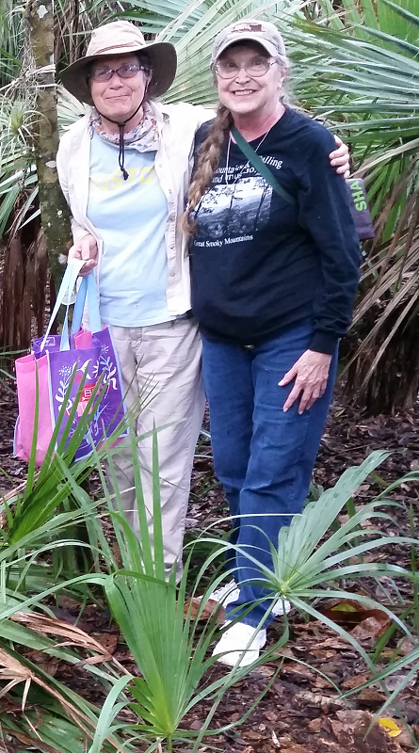
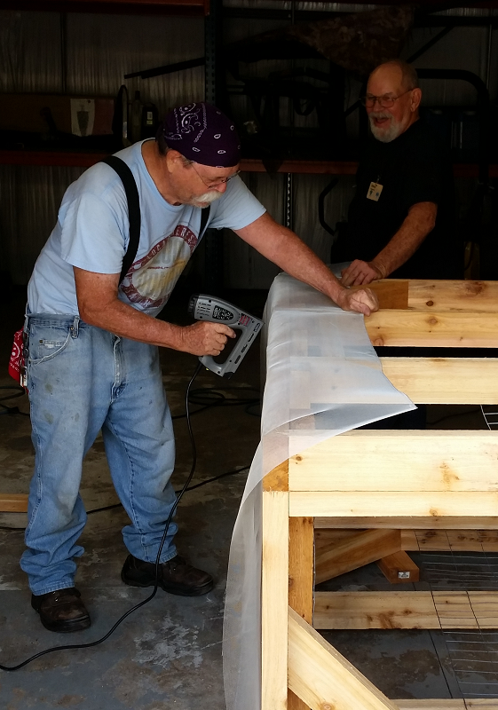
Saving the GAPs in the Enchanted Forest Sanctuary
Meet the Volunteers

Slide 4
Saving the GAPs in the Enchanted Forest Sanctuary
2015
Rescuing GAPs and keeping them safe.
METHOD Development: Not just for the Enchanted Forest, but Natural Areas throughout Central and South Florida who want to save their GAPs.
Difficulties:
Many different habitats;
GAP populations of different sizes and demographics;
Must meet the needs of the volunteers and land managers who will be using the method.

Slide 5
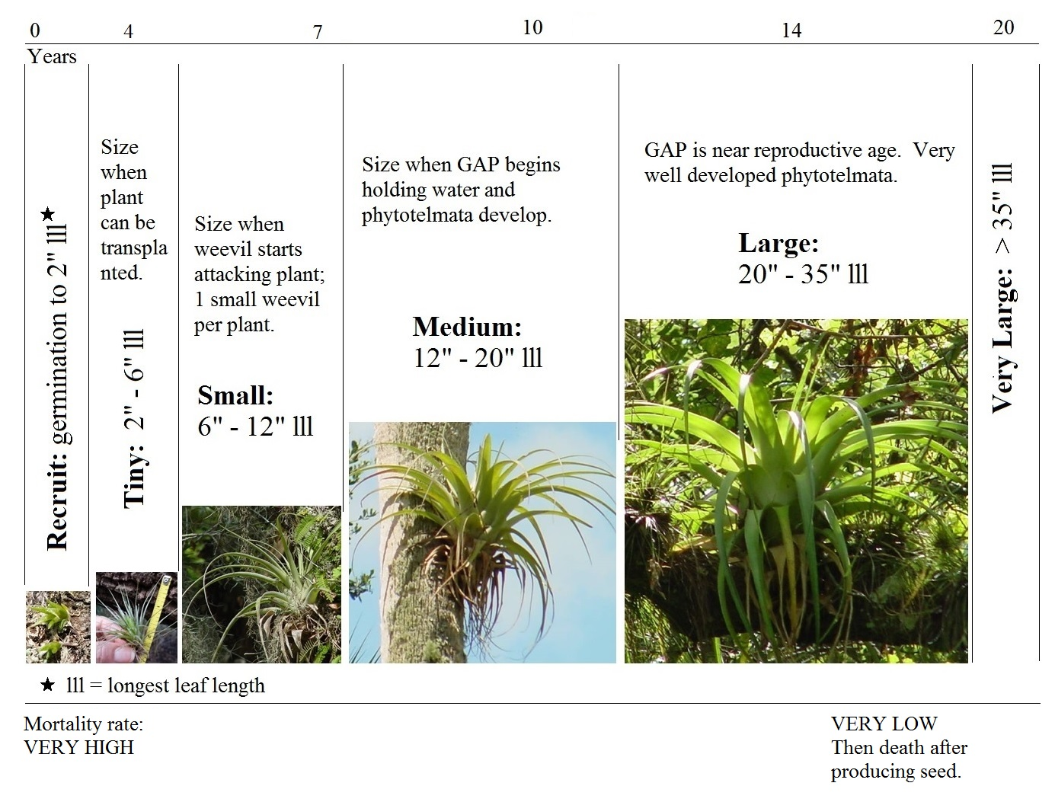
More difficulties:
GAPs are large plants, long lived.
Previous efforts to save bromeliad seeds in Florida did not work.
Requires space, time, and passing responsibilities to next generations.
Goal: To keep GAPs alive in Florida until we can find a way to control the weevil.
This could take many years; decades or more.

Slide 6
If many Natural Areas across Central and South Florida each work to conserve a small number of GAPs on their lands, we can collectively maintain GAP abundance and diversity while we search for a solution to the Mexican bromeliad weevil.

Slide 7
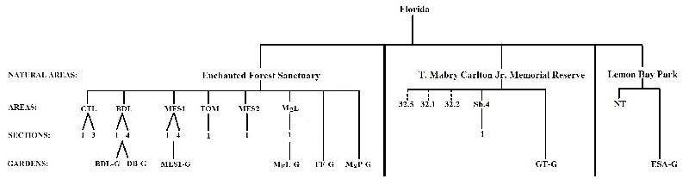
Develop a standard method for conserving and protecting the Giant Airplant on Natural Areas in Central and South Florida
Provide a method for Land Managers and volunteers for conserving GAPs on their land.
Provide a network for Land Managers and volunteers from different Natural Areas to communicate about what they are doing and about their successes and failures.
Provide consistent data collection for the development of the method and for monitoring our progress, and for RESEARCH!
Provide a network for making things happen.

Slide 8
It is necessary that we do this in an organized and methodical fashion.
I do not know how we should form the organization, but I have some pretty good ideas on how to create a usable, efficient method for conserving GAPs on our Natural Areas.
Today, I’m going to talk about that method.

Slide 9
Develop a standard method for conserving and protecting the Giant Airplant on Natural Areas in Central and South Florida
Natural Area: A park, sanctuary, reserve, preserve, or other managed land in Central or South Florida with GAP populations.
Areas: Localized wild GAP populations in a Natural Area.
Gardens: Places in a Natural Area’s forests where rescued GAPs are gathered, nurtured, and protected, with the goal to create seed to release back into the wild Areas.
Containment conditions: A location outside of a Natural Area’s forests (such as Selby and Naples BG; volunteers keeping plants; or cages) where rescued GAPs are contained and protected until the plants release seed.

Slide 10
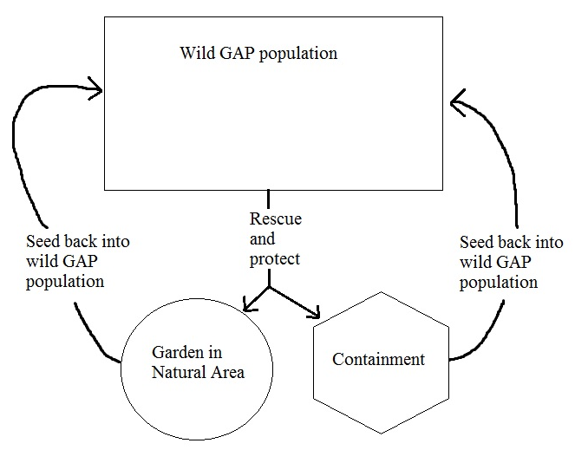
For a given Natural Area, GAPs are rescued and taken to Gardens or put under containment conditions, where the GAPs are protected until they produce seed, then the seed is re-introduced to the Natural Area where the seeds came from.
IF THE GAP IS EXTIRPATED IN FLORIDA, IT WILL NOT BE BECAUSE THE WEEVIL ATE THE LAST GAP, BUT BECAUSE GAP SEED OUTPUT FELL BELOW A THRESHOLD TOO LOW TO SUSTAIN THE GAP POPULATION.
We must increase seed output and get the next generations started!

Slide 11
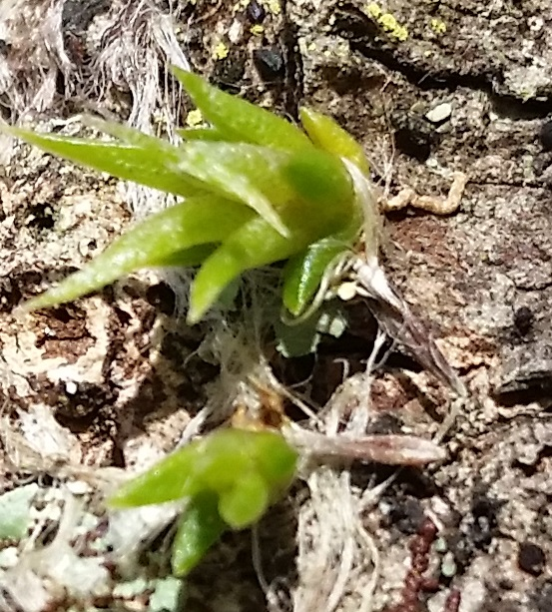
Data collection will be more intense at the start of using the method because we will have to make sure our efforts are working and determine which procedures work best for rearing GAPs in the Gardens and for releasing seed back into the Forests.
There will be standardized forms that are in the same format as data entry into the spreadsheet.
There will be five data sets; three counts will be made annually and four data sheets will be filled out throughout the year.
Data and summaries will be submitted for central storage, organization, analysis, and presentation.
Annual counts are made in the winter months and submitted at the start of the year following data collection (WEB SITE).
Sherm’s recruits in Carlton Reserve

Slide 12
The data/spreadsheets are:
Annual Counts | To be filled out throughout the year
Wild GAP counts in mapped Areas
Garden Counts | Garden maintenance
Containment Counts | Containment maintenance
 | Seed Release and Recruitment
 | Weevil Counts

Slide 13
Size categories are used in monitoring wild, garden, containment, and recruitment GAP populations.
Monitoring wild population will let us assess our progress; success will mean greater numbers of GAPs in the wild, but also more large and very large GAPs – sign of healthy population and more ecologically important with increasing size (phytotelmata, nutrient flows, water availability).

Slide 14
Medium GAPs or larger can produce an inflorescence and release seed; size may have an affect on seed output or viability.
By monitoring the recruits, tiny, and small plants we can make assessments about their survival and methods of propagation.
Overall organization of Garden or Containment conditions.

Slide 15
Wild GAP Counts in Mapped Areas
Method based on research used at
Myakka River State Park
and
Enchanted Forest Sanctuary

Slide 16
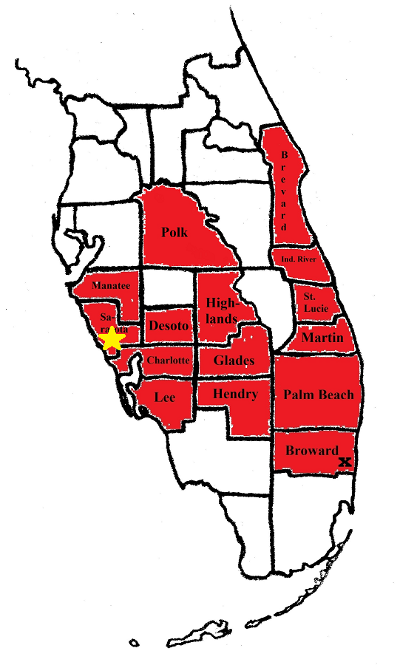
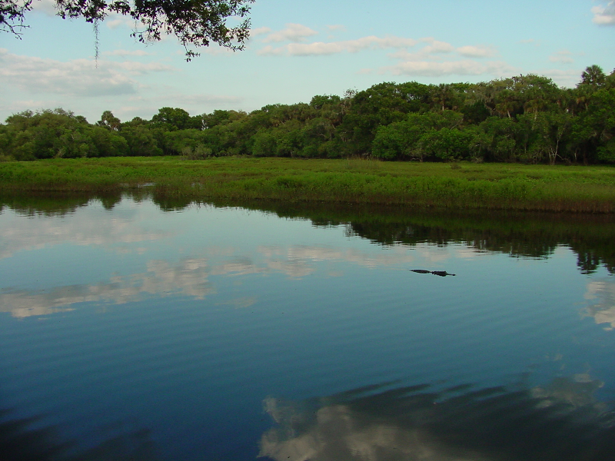
Monitoring wild GAPs using transects:
Based on research started in Myakka River State Park in 2001.

Slide 17
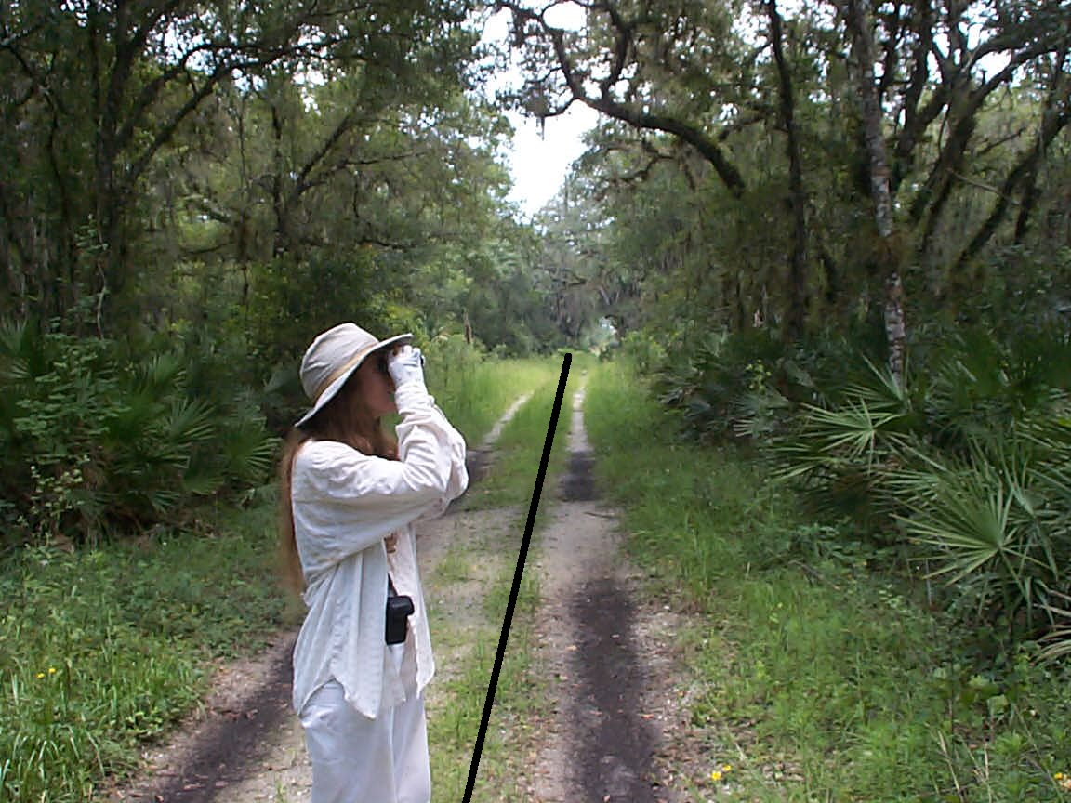
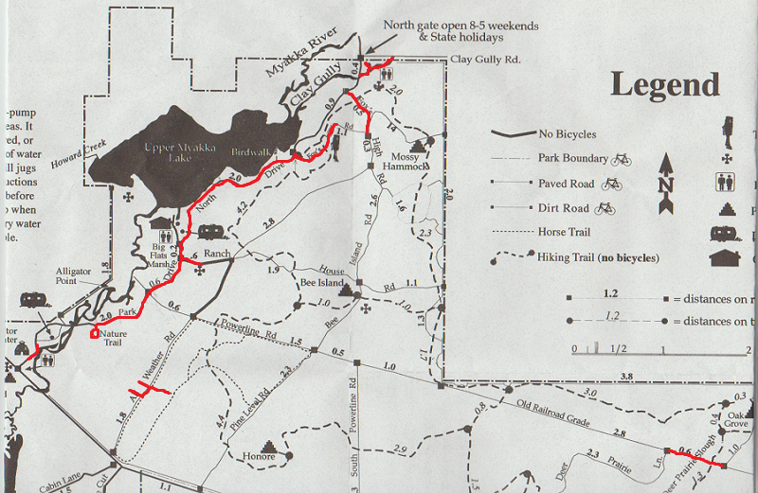
Myakka River State Park
Using transects to map and monitor bromeliads.

Slide 18
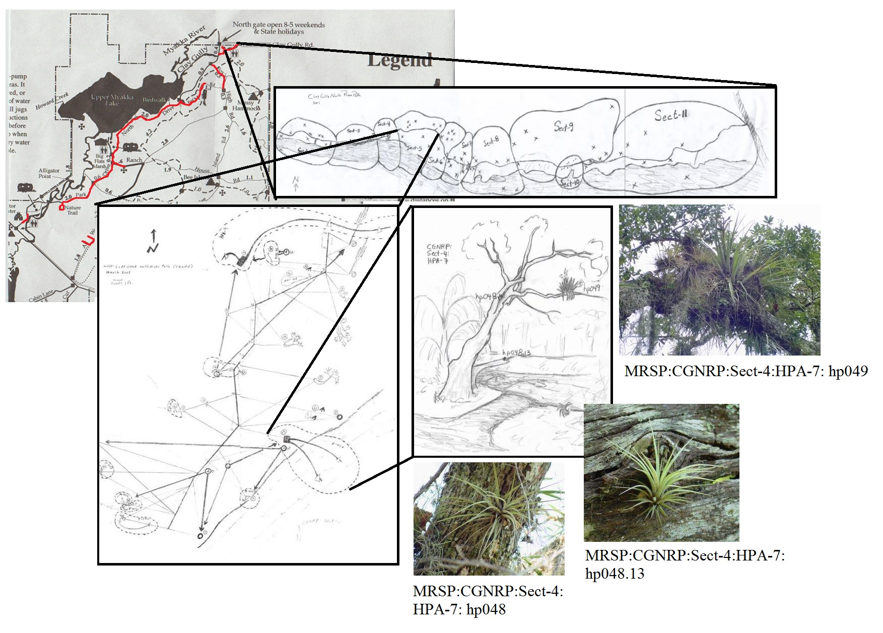
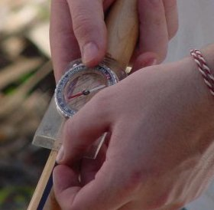
Natural Area:
Myakka River State Park
(MRSP)
Area:
Clay Gully North River Park
(CGNRP)
Section: S-4
Host Plant Area:
HPA-7
Host plants:
hp048, hp048.1, hp049

Slide 19
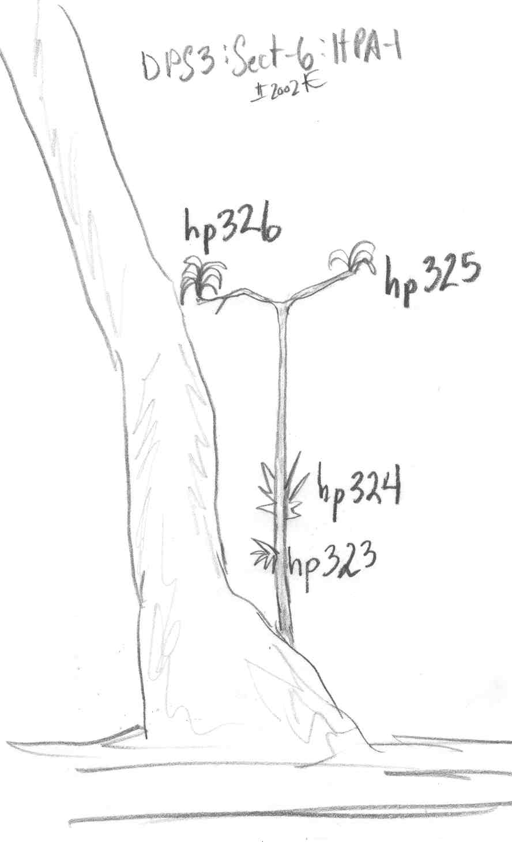
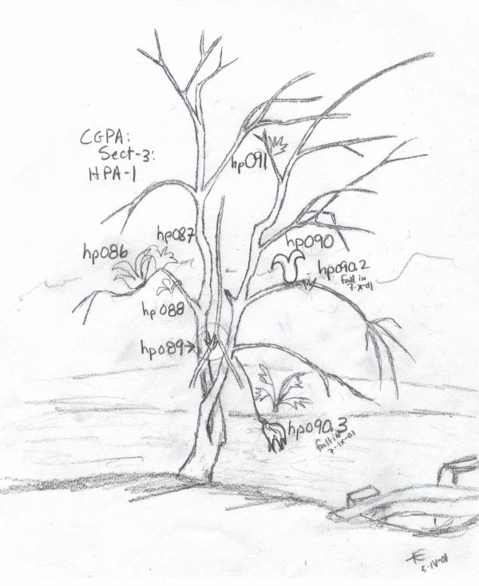
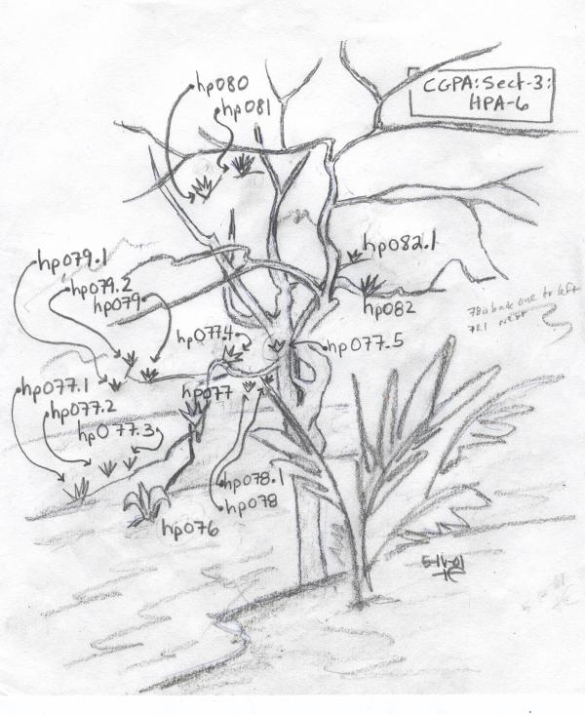
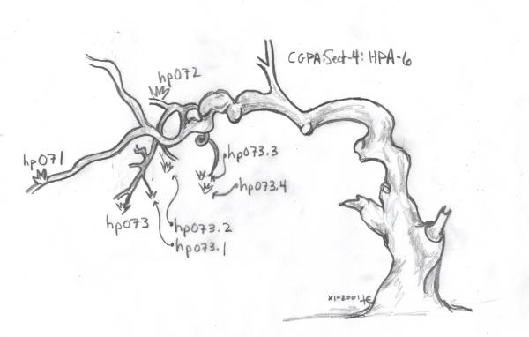
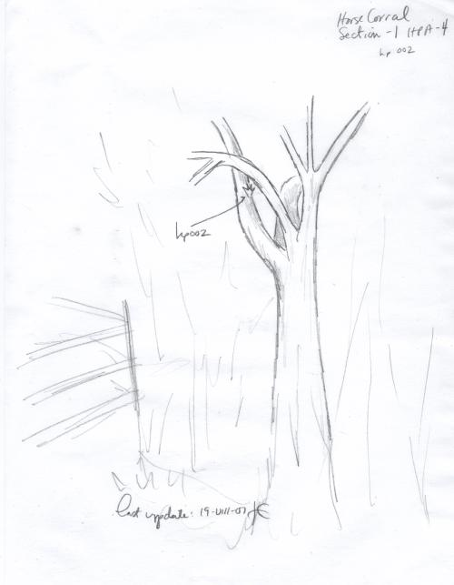
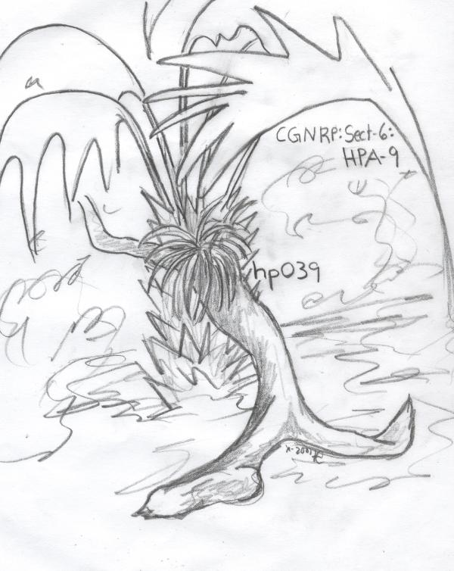
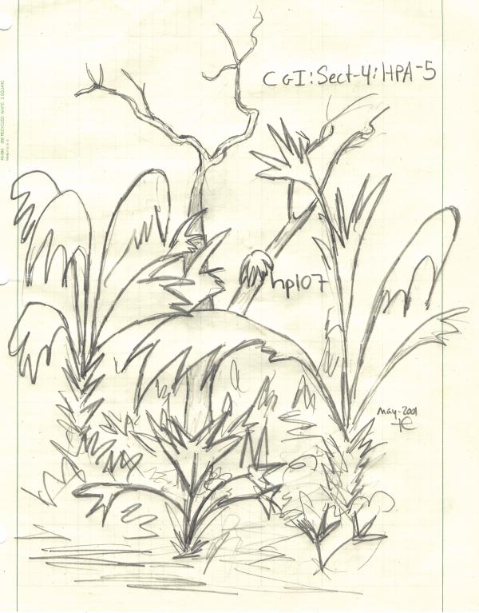
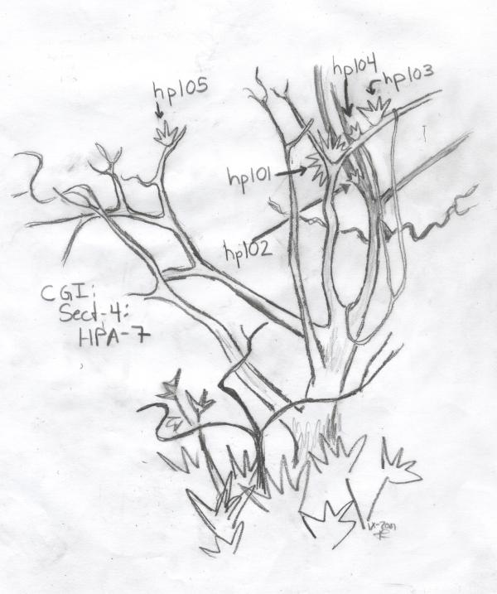
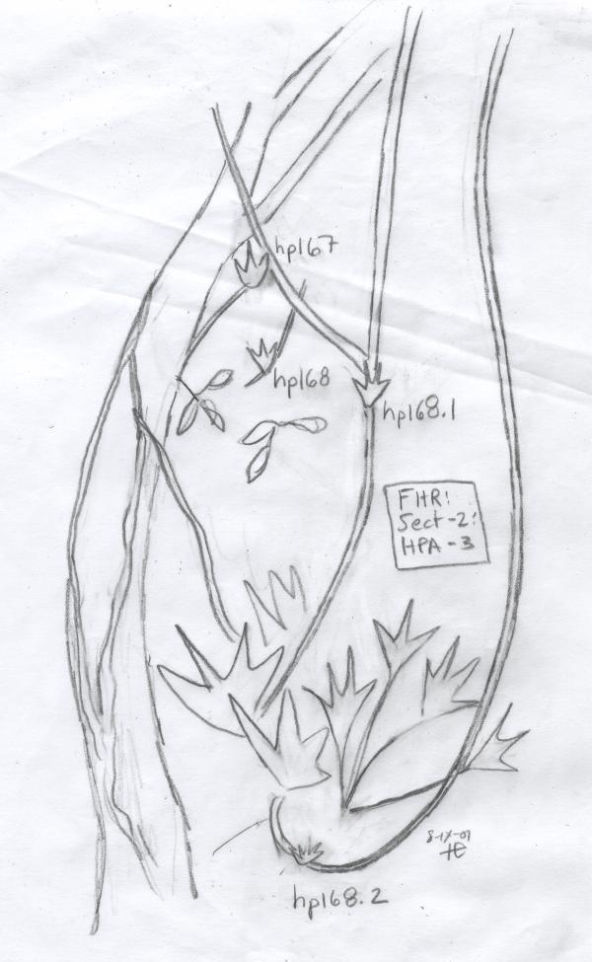
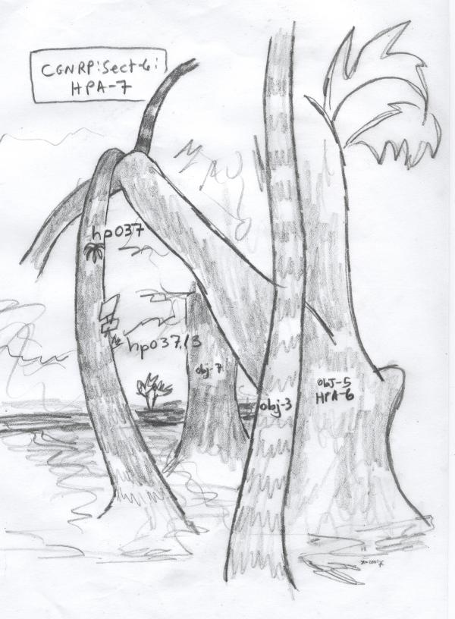
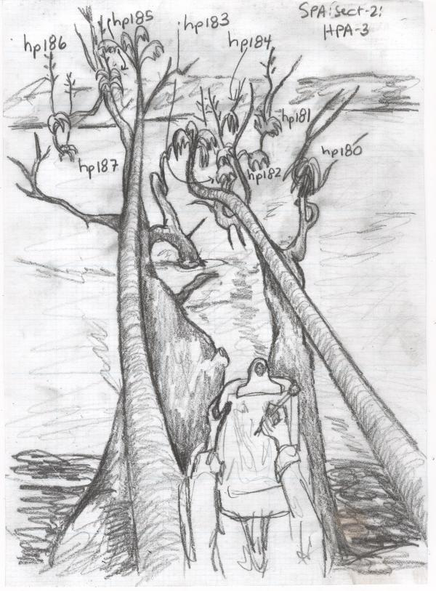
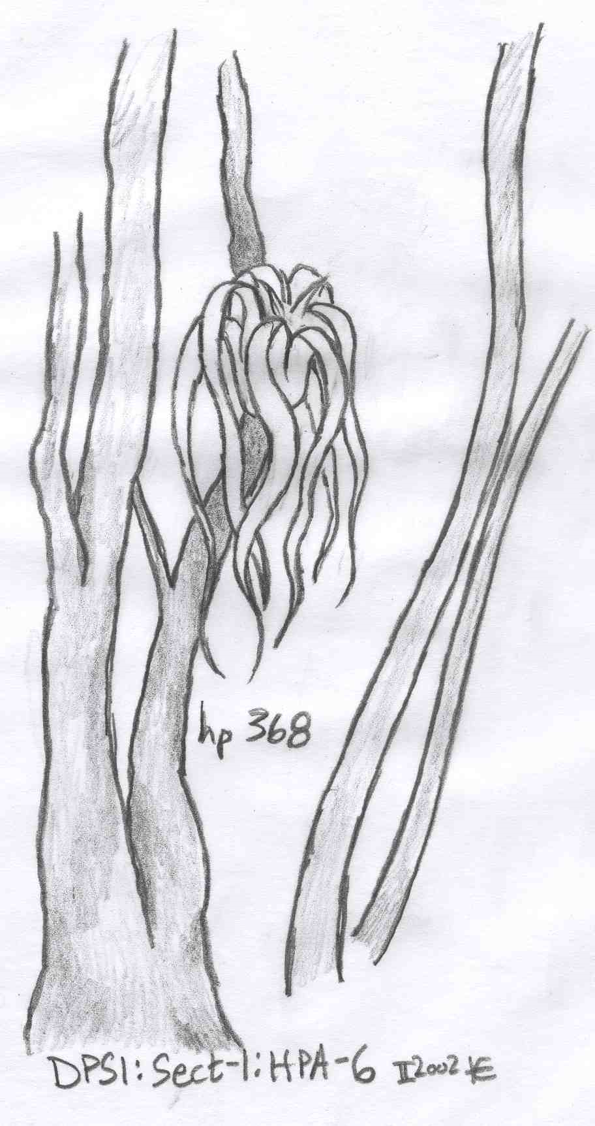
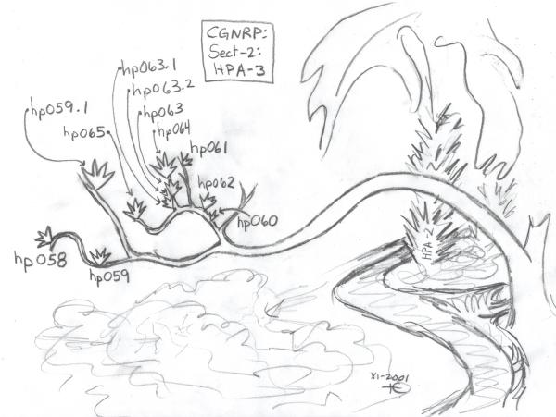
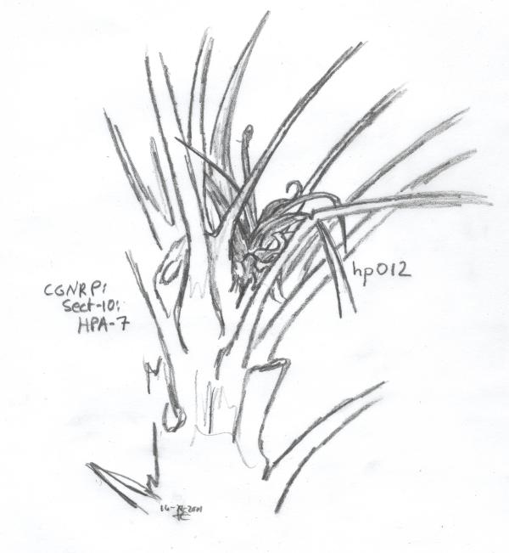
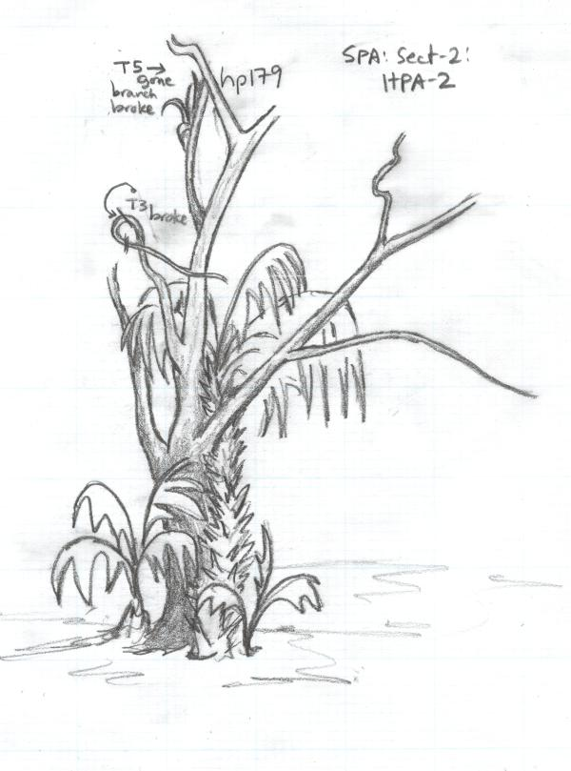
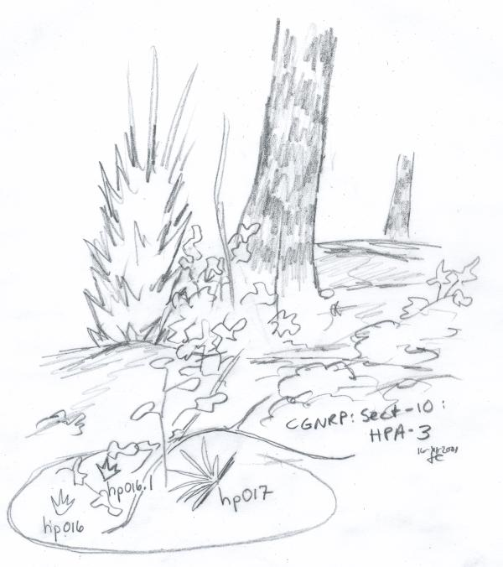
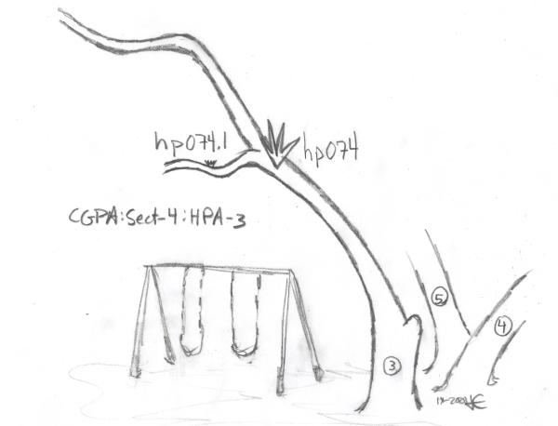
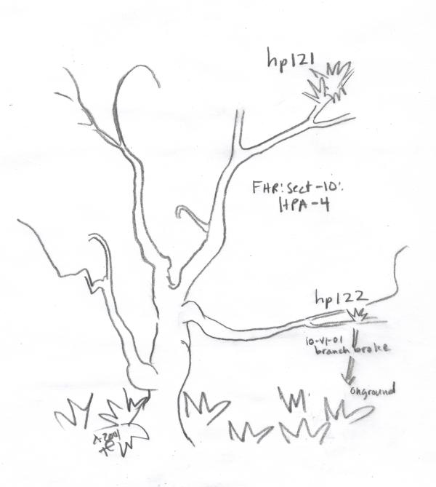

Slide 20
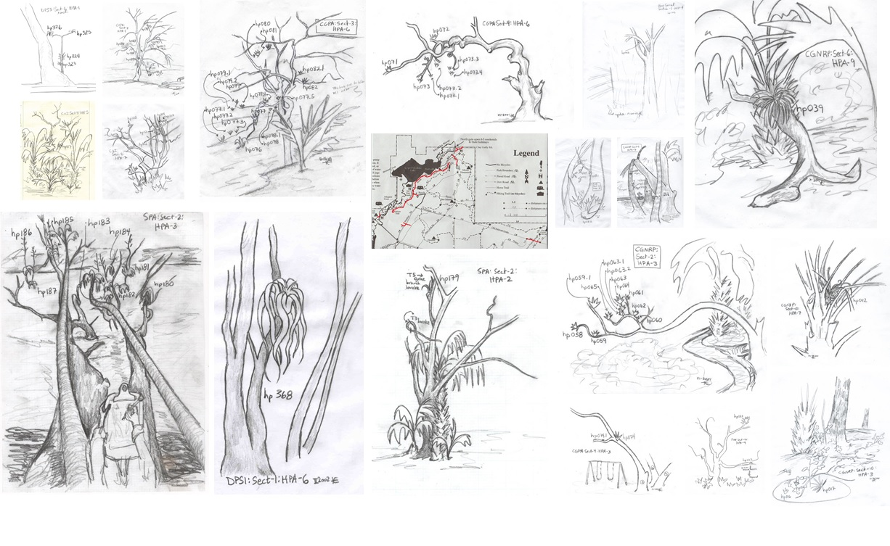
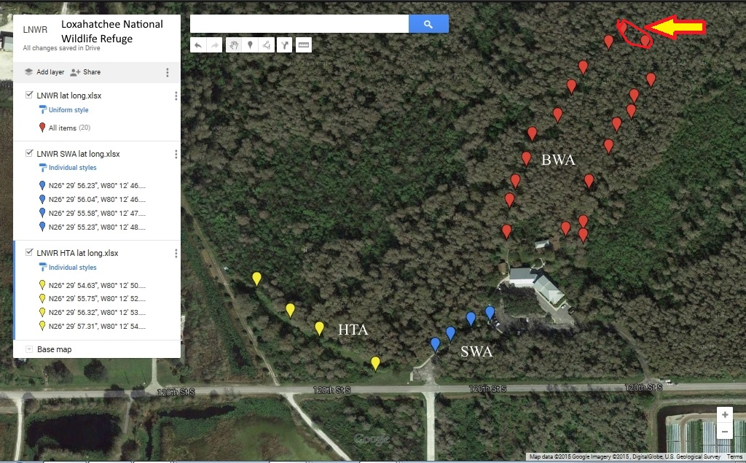
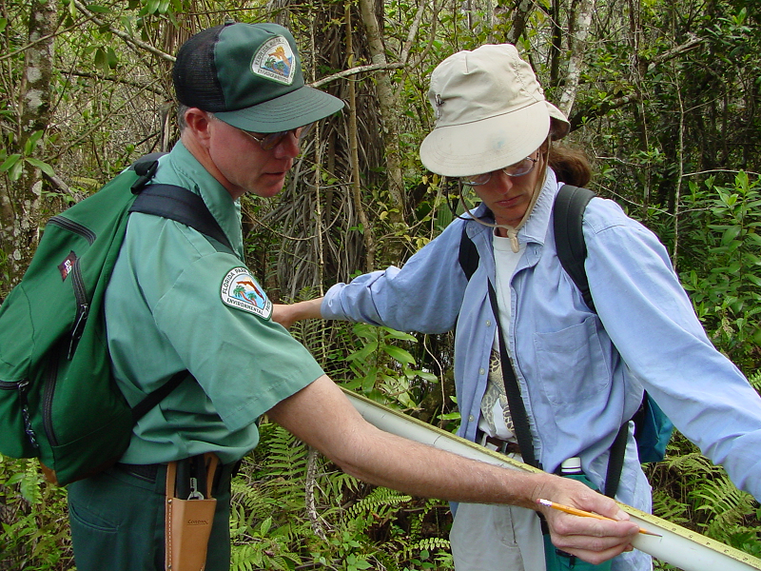
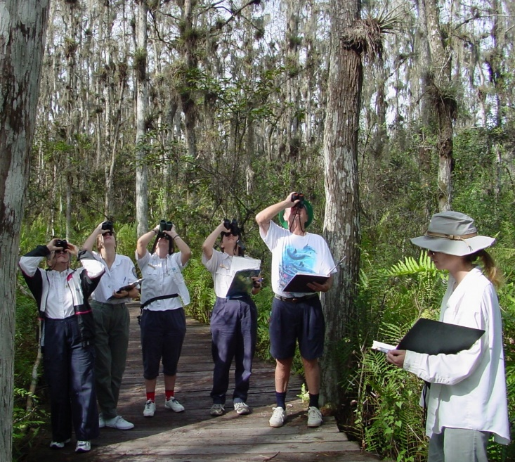
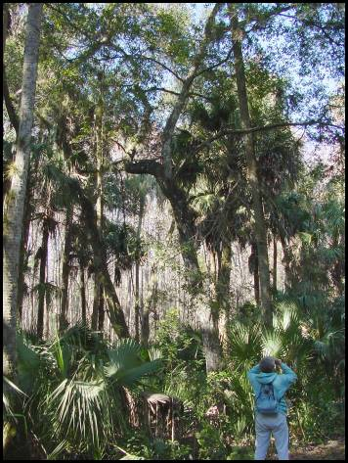
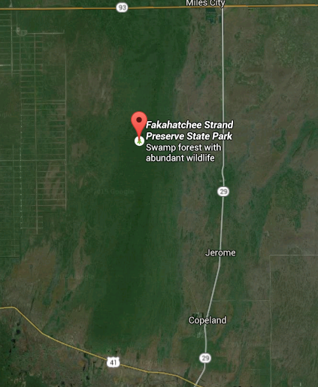
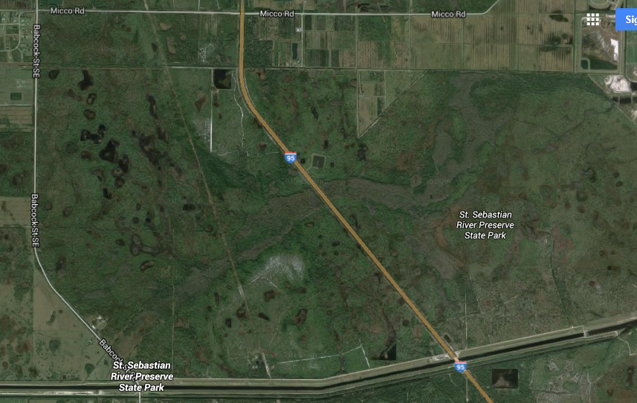
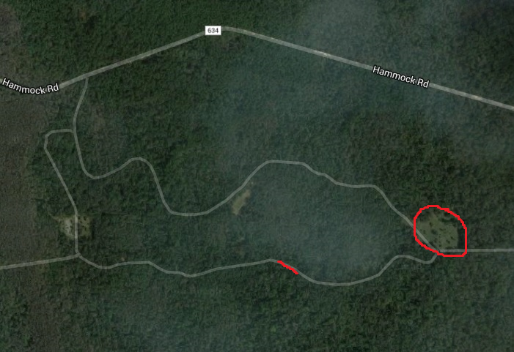
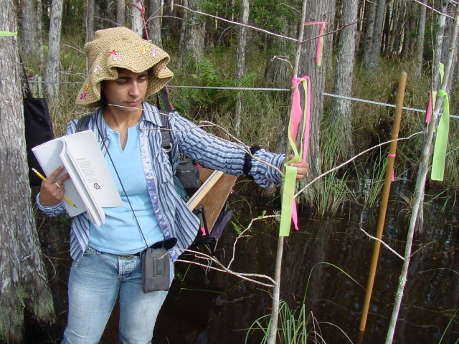
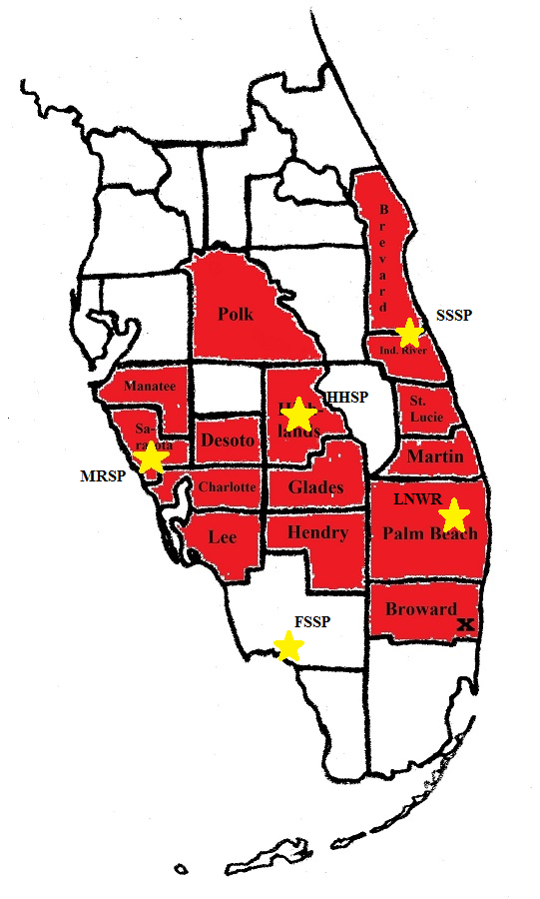
MRSP 2001 - 2005
Loxahatchee National
Wildlife Refuge
(LNWR) 2002
Fakahatchee Strand
Preserve State Park
(FSSP) 2003
Highlands Hammock State Park
(HHSP) 2002
St. Sebastian River Preserve State Park
(SSSP) 2003

Slide 21




Slide 22


Seasonality of weevil on GAP versus Cardinal Airplant

Slide 23
Median time to failure of Tillandsia utriculata and T. fasciculata with upper and lower boundaries, according to size and mode of failure
Small: Disappearances and other kills caused by flooding, storms, high winds, fallen trees and branches, and herbivory (other than M. callizona, such as from lepidopteran larvae or squirrels). All small bromeliads that were killed were at the high end of the small category, with lll of 10 to 15 cm. Only one small weevil per plant.
Medium: Disappearances and other kills also caused by catastrophic events and other herbivores. As medium plants increased in size and mass, they disappeared less frequently, became less susceptible to catastrophic events and climatic changes and weevil-killed plants were more often and usually with more than one weevil specimens and/or pupal chambers.
Large: Disappearances and other deaths caused by catastrophic events and human theft. Weevil deaths had a significantly earlier median time to failure than other deaths or disappearances. Individual large bromeliads were capable of supporting several weevils.
Cooper 2006

Slide 24
Total number of dead bromeliads fallen from canopy into mapped Sections, collected, and categorized as percent killed by M. callizona or killed by cause other than M. callizona.
Natural Area | Months monitored | Total Number Fallout | % - M. callizona | % - other
MRSP | 49 | 652 | 78% | 22%
LNWR | 28 | 93 | 71% | 29%
HHSP | 33 | 31 | 77% | 23%
FSSP | 24 | 9 | 0% | 100%
SSSP | 17 | 158 | 82% | 18%
71% to 82%? There had been some GAP sites of such rapid and great destruction that I wondered, would a large, dense population of GAPs have a quicker rate of destruction by the weevil?

Slide 25


The Enchanted Forest Sanctuary:
Mapped and monitored from March 2007 to June 2009.
TOO MANY GAPS TO COUNT!
Mapped using transect method, but only counted those GAPs within 7.5 meters on both sides of the transects; did a population count, did not give numbers or relocate individuals on the counts.
Only counted those GAPs with a longest leaf length of 12” or longer (way too many tiny and small GAPs to count; this size and larger more visible and preferred sizes for the weevil).
Enchanted Forest Sanctuary

Slide 26

GAP survival at EFS.
Tillandsia utriculata at the Enchanted Forest Sanctuary
 | time = 6 months | time = 25 months
% T. ut. population remaining (99% of deaths caused by weevil): | 13% | 2.4%
Amount of bromeliad water lost (liters): | 13,577 | 2,772
 |  | Total: 16,350

Slide 27

GAP size demographics at EFS.

Slide 28
How to map Areas on your Natural Area.

Slide 29



Locate GAP populations on your Natural Area. Ride and walk along roads, trails, and paths and note those that pass through GAP populations; off-trail is okay, too.
Relative abundance and rough estimate of populations.
EFS: In 2007, one large, dense GAP population, extending outside of monitoring area on northern edge; a few small, satellite populations.
LBP: Large, sparsely distributed GAPs along North Trails and small, localized GAP populations in hammock.
CR: Very large Natural Area with many small, localized GAP populations.

Slide 30
A road that passes through a GAP population is considered an Area. Go to an Area that you want to map. Give the Area a name and an acronym. Consistently use these names.
A transect will be laid down in the Area and used to make a count of the GAPS in the Area.
The location of the transect is fixed and does not
change.
The transect will follow the road. There will two
ends to the transect, which are determined by
the beginning and end of a road; and/or the
beginning and end of a GAP population along
the road. Determine the ends then decide which
end is the start of the transect and which end is
the finish.
If the transect is very long, then it should be
broken into Sections to make counting and
data sorting easier.
Get the lat-longs for beginning, finish, and Sections.

Slide 31

Estimate on the number of GAPs in the Area.
If there are ≤ 100 GAPs, use a LOW COUNT.
If there are > 100 GAPs, use a HIGH COUNT.
For both counts:
Start at the beginning of the transect and walk very, very
slowly to the end of the transect.
Count all GAPs with a longest leaf length of 12” or greater;
sort into size categories and with an inflorescence
(developing or seed released).
You can turn around and look back, but make sure you
don’t count GAPs twice. Look as thoroughly as you can.
Do not anticipate seeing GAPs – Do not look for those that
you know are there; approach the count as if you have never been to this location, and expect to see a GAP anywhere.
MAKE IT AN HONEST COUNT!

Slide 32

For HIGH COUNTs:
For HIGH COUNTs:
Determine a distance from the transect to include a portion of the GAPs in the Area, run lines parallel to the transect at that distance on both sides, and count GAPs (12” lll or greater) only in that Area.

Slide 33


For LOW COUNTs:
CR:Sb.4
For LOW COUNTs:
Count every GAPs (12” lll or greater) you can see as you walk along the transect; look through the forest. Distinguish between groups in Areas and outliers. Measure distance to nearest trees and most distant GAPs in the group.

Slide 34


Slide 35
A given Area will change from a HIGH COUNT to a LOW COUNT if the GAPs in the Area falls below 100; this happened in the Enchanted Forest because the weevil killed so many GAPs.
Hopefully, with success, we will get Areas with increasing GAP counts and we will have to change LOW COUNTS to HIGH COUNTs.
The transect does not change.
Begin LOW COUNTS
Example: Enchanted Forest

Slide 36
Loxahatchee National Wildlife Refuge
Another Example of a HIGH to LOW count because of the weevil.
Method will expand to include other species of bromeliads in Florida that are being attacked by the weevil, but first, the GAP.

Slide 37
Data collected for wild counts:
Initial mapping and base count; draw maps to show landmarks to make counting easier.
Give length and direction of transect. HIGH Count: distance measured from transect for counting; LOW Count: distance to furthest GAPs in group and outliers.
Does canopy cover transect? If no, how far are the nearest trees?
Count GAPs and inflorescences.
(Do not count the GAPs that were deliberately put out to release seed.)

Slide 38
Annual Wild GAP Counts, example: Lemon Bay Park: North Trails.
Time moves this way….
Natural Area | Area | Section | GAP | 2015 | 2015 | 2015 | 2016 | 2016 | 2016
 |  |  |  | Medium | Large | Very Large | Medium | Large | Very Large
LBP | NT | 1 | no inf | 3 | 0 | 0
LBP | NT | 1 | inf developing | 0 | 0 | 0
LBP | NT | 1 | inf releasing or has released seed | 1 | 2 | 0
LBP | NT | 2 | no inf | 13 | 3 | 0
LBP | NT | 2 | inf developing | 0 | 0 | 0
LBP | NT | 2 | inf releasing or has released seed | 2 | 3 | 0
Data to be entered next year.
More Areas can be added going down the rows.

Slide 39
GARDENS

Slide 40
GARDENS
Gardens should be many and small instead of few and large.
When a Garden is set up, the Garden should be given a name and the boundaries of the Garden should be determined.
Take the lat-long of the center of the Garden and measure approximate Area.
Draw and give a general description of the Gardens.
Annual count: Meticulous count of all GAPs in the Gardens and method of rearing, and summary of deaths and seed release from previous year.

Slide 41
GARDENS
Throughout the year: Monitor GAP rearing methods.
Grow the GAPs on structures designed for rearing the plants.
Mobile structures:
Garden GAPs can be removed in case of need to burn or otherwise maintain location of Garden;
Can transition plants easy when it is time to put the plant out to release seed; or for other reasons;
Will make counting and keeping data easier and will define and limit our gardens (we are not trying to save every GAP, we are trying to increase seed output).

Slide 42



GARDENS
Can study which methods work best under what conditions for which size categories.
Structures are numbered, kept in a data sheet, and when Gardens are checked, information is filled out for each structure.
All GAPs that initially go into a structure (a cohort) stay together until they die or are put out for seed release.

Slide 43

Six gardens (defined, named, and mapped)
Plants rescued and placed as safely as possible.
GARDENS at the Enchanted Forest
General count of tiny and small GAPs rescued by volunteers in the Enchanted Forest in 2015.
Need to keep close tabs on GAPs that we grow in our Gardens – what works, what doesn’t work (we have the numbers!), measuring germination, growth and survival rates.
Tiny and small GAPs placed on a Sabal palm stump in Magnolia Loop Garden, to keep the plants off of the ground and safe from rot.

Slide 44
GAPs in a similar size category are kept on a structure (no mixing of sizes).
Easier to count, easier to measure growth and survival rates.
Easier to organize.
Different size categories may require different conditions/management.
A cohort is monitored until all GAPs die or are put out for seed (on same structure or moved).

Slide 45
Annual Garden Counts, example: Carlton Reserve: Garden Ten-Garden.
Natural Area | Garden | Structure # | Structure | 2015 | 2015 | 2015 | 2015 | 2015 | 2015
 |  |  |  | Rec | Tiny | Small | Med | Lg | Very lg
CR | GT-G | 1 | Hanging basket |  | 11
CR | GT-G | 2 | Hanging basket |  | 9
CR | GT-G | 3 | Hanging basket | 3
CR | GT-G | 4 | Hanging basket | 28
CR | GT-G | 5 | Hanging basket | 2
CR | GT-G | 6 | Hanging basket | 9
CR | GT-G | 7 | Hanging basket | 1
CR | GT-G | 8 | Hanging basket | 2
CR | GT-G | 9 | Hanging basket | 8 | 1
CR | GT-G | 10 | Hanging basket | 0
CR | GT-G | 11 | Hanging basket | 5
CR | GT-G | 12 | Hanging basket | 45
CR | GT-G | 13 | Hanging basket | 0
CR | GT-G | 14 | Hanging basket | 42
CR | GT-G | 15 | Nursery box |  | 14
CR | GT-G | 16 | Nursery box |  | 9 | 3
CR | GT-G | 17 | On peeled bark on HW cloth | 6
CR | GT-G | 18 | On peeled bark on HW cloth | 20
CR | GT-G |  | Total: | 171 | 44 | 3 | 0 | 0

Slide 46
CONTAINMENT

Slide 47

Containment
Removing GAPs from the Forests and put them in a place where they can be protected from the weevil.
Cages: In the laboratory, how I protect bromeliads to be used for research from being eaten by the weevil.
Also:
Selby and Naples Botanical Gardens
Homeowners
Bromeliad growers
NEED PERMITS!
Can use insecticides to protect the GAPs; by putting the GAPs in cages, can insecticide once and leave in cage for 1 to a few years, until time for seed release.

Slide 48
The CAGES at the Enchanted Forest were funded by the Florida Council of Bromeliad Societies.
Idea: Funding to supply Natural Areas with tools to start monitoring program:
Cages
Boxes
Rope
Hardware cloth
Sticks
GPS

Slide 49
Annual Containment counts, example: Enchanted Forest Sanctuary: Cages.
Natural Area | Containment | GAP | GAP size | 2015 | 2015 | 2015 | 2015
 |  |  |  | Small | Med | Lg | Very lg
EFS | Cage in EFS | no inf | sm | 17 | 48 | 10 | 1
EFS | Cage in EFS | inf developing | m-sm, md | 0 | 11 | 1 | 0
EFS | Cage in EFS | Total Removed for seed release | m-lg, lg | 0 | 0 | 0 | 0

Slide 50
Containment Counts Regular Visits, example: Enchanted Forest Sanctuary: Cages.
Natural Area | Containment | Date | Researchers | GAPs introduced | GAPs dead | GAPs or GAP seed to wild
EFS | Cages in EFS | 9-Dec-15 | Teresa, Martha, Lora | 1 large GAP in Cage | 0 | 0

Slide 51
SEED RELEASE AND RECRUITMENT

Slide 52
Annual Recruitment Counts
Seed will be released and propagated in different ways.
Must keep good records on how the seed is used and what the outcome is.
Soon, we will have more recruitment sites than we can handle.
For each GAP whose seed is used:
Assign Rec#
How used (released, propagated in Areas or Gardens, method)
Recruitment or no?
Randomly select some Recruitment Sites for monitoring until the transition from recruits to tiny.

Slide 53
Random selection, number must be decided keeping in mind that the total number of sites being monitored will equal sites from 2 to 4 years of seed release/propagation.
Example:
Year 1: 3 sites
Year 2: 3 sites
Year 3: 3 sites = 9 sites
Year 4: those from Year 1 transition out, 3 new transition in to hold steady at 9.

Slide 54
Annual Recruitment Counts: Carlton Reserve.
Natural Land | Rec # | Area/location | Date out | Actions (if more than one action is done for seeds from a single inflorescence, attach a, b, c, etc. to the rec # for each action) | Check: Germination or no? Give date checked; if yes, continue to columns E, F, and G | # of seedlings that germinated | Approx size of seedlings (give range if necessary) | Monitored? (Randomly select some rec sites for cont'd monitoring)
CR | 1 | Sb.4 | Spring 2015 | Inflorescence was stapled to trunk of a tree. | Yes.
CR | 2 | LOC mule shed | Spring 2015 | Inflorescence was stapled to trunk of a tree. | Yes.
CR | 3-a | REC AREA name | Spring 2015 | Seed from an inflorescence was spread on trunks of trees. | Yes.
CR | 3-b | REC AREA name | Spring 2016 | Seed from an inflorescence was spread on trunks of trees. | Yes.
CR | 3-c | REC AREA name | Spring 2017 | Seed from an inflorescence was spread on trunks of trees. | Yes.
CR | 3-d | REC AREA name | Spring 2018 | Seed from an inflorescence was spread on trunks of trees. | Yes.
CR | 3-e | REC AREA name | Spring 2019 | Seed from an inflorescence was spread on trunks of trees. | Yes.
Need data.
Need to determine method for selecting random portion of res sites for cont'd monitoring.
For the selected Recruitment sites, monitor each year for number and size of recruits, until the recruits reach size limit to become tiny Tillandsias.
Year 1: Give date | Year 1: # of recruits | Year 1: Approx size of recruits (give range if necessary)

Slide 55
Annual Recruitment Counts
We must be methodical in how we put seed out!
Selby and Naples BG: Back where the original plants came from.
Other methods: Releasing in known GAP habitat, or previous Giant locations.
Other methods: Releasing in an Area that looks like good habitat.
Propagating in wild Areas and Gardens.
Other types of recruitments:
Germinating seeds in Gardens or Containments, then putting plants out?
Much to be worked out.

Slide 56
WEEVIL COUNTS

Slide 57


Weevil Counts.
In regular movement about Natural Area, look for fallen, dead GAPs; if killed by the weevil, search for weevils.
Silky can weevil
Metamasius hemipterus
Mexican bromeliad weevil
Metamasius callizona
Florida bromeliad weevil
Metamasius mosieri

Slide 58




The Mexican bromeliad weevil has four life stages:
egg, larva, pupa and adult.
The larva is the life stage that kills the host bromeliad.
Adult and egg.
Larva.
Larvae and pupae must be reared to adults to id species.
For the brave: How to rear weevils.
Pupa.
Pupal chambers.

Slide 59


Tillandsia utriculata: Killed by the weevil
May 2003
June 2003

Slide 60






M. callizona damage on bromeliads

Slide 61
Weevil Counts Regular Visits, example: Enchanted Forest Sanctuary.
Natural Area | Date | Location | weevil larvae (if reared to adult, indicate species in Col I) | weevil pupae (if reared to adult, indicate species in Col J) | Mexican bromeliad Weevil adults | Florida bromeliad weevil adults | Other weevils | Larva reared to adult: what species? | Pupae reared to adults: what species?
EFS | 2-Dec-15 | MgL-G | 0 | 1 | 0 | 0 | 1 | MBW | n/a
EFS | 2-Dec-15 | BDL | 0 | 0 | 1 | 0 | 0 | n/a | n/a
EFS | 2-Dec-15 | FF-G | 1 | 0 | 0 | 0 | 0
Need to know where the weevils are and where they are going!
Will give us more sightings to better map the weevils in Florida.

Slide 62
This method is a work in progress:
Refining rearing and propagating procedures;
Finding alternative ways to protect the GAPs from the weevil;
Refining data collection after many years of data have been collected;
Adapting to the changing GAP populations as we succeed.

Slide 63
Other techniques: Trap Pineapple Plants
Might work in one of two ways:
Remove so many weevils that it reduces the wild weevil population (NOT LIKELY);
Distract weevil from Gardens or other GAPs we want to protect.
One season in the field, need another season of data.
Some hits, need to process data and make assessment.
Managing the PATs is a lot of work; why waste effort if it isn’t working?

Slide 64
Other techniques: Biopesticides and natural repellants
We must have a means to protect the GAPs in the Gardens! Right now, tiny and small plants; once medium and larger, the weevil will be attracted.
Research shows some promise using entomopathogenic fungi and neem oil (and researching other possibilities).
Need more research in the laboratory, and then in the field.
Research in laboratory, then in Gardens, then in fields, may then be extended to use by homeowners and growers and other people trying to protect bromeliads.

Slide 65
NOTE: The Giant Airplant is on Florida’s list of endangered plants and permits are required to move GAPs from one Natural Area to another. However, GAPs may be manipulated on a Natural Area if the Land Manager gives permission for the manipulation and if the Land Manager or her or his agents do the manipulation. Therefore…
This method will be designed to be used by Natural Areas, but each Natural Area will be responsible for the conservation efforts and data collection that is done on their land and these actions will be done with the Natural Area’s Land Manager’s knowledge and permission and will be performed by the Land Manager or her or his agents. This makes permits unnecessary.

Slide 66
However, there may be times when permits are necessary.
Certain research;
Movement to and from Containment;
Rescuing GAPs about to be destroyed from construction or other maintenance;
Re-seeding Natural Areas where GAPs have been lost;
What else?
Write up method as framework for these situations and work with DPI.
We are just at the beginning!

Slide 67




Now we map and monitor not to watch the destruction of the GAPs, but to watch the GAPs recover.

Slide 68




Many thanks to our supporters…
South Florida Water Management District
Florida Council of Bromeliad Societies, Inc.
Department of Environmental Protection
Florida Park Service
University of Florida

Slide 69
email: tmcooper@ufl.edu
Subject line: GAP – followed by your words

