Slide 1
A Fakhatchee Intervention
Bruce Holst
Botany Department
Marie Selby Botanical Gardens
Sarasota, Florida, USA

Slide 2
Intervention: March 5, 2014

Slide 7
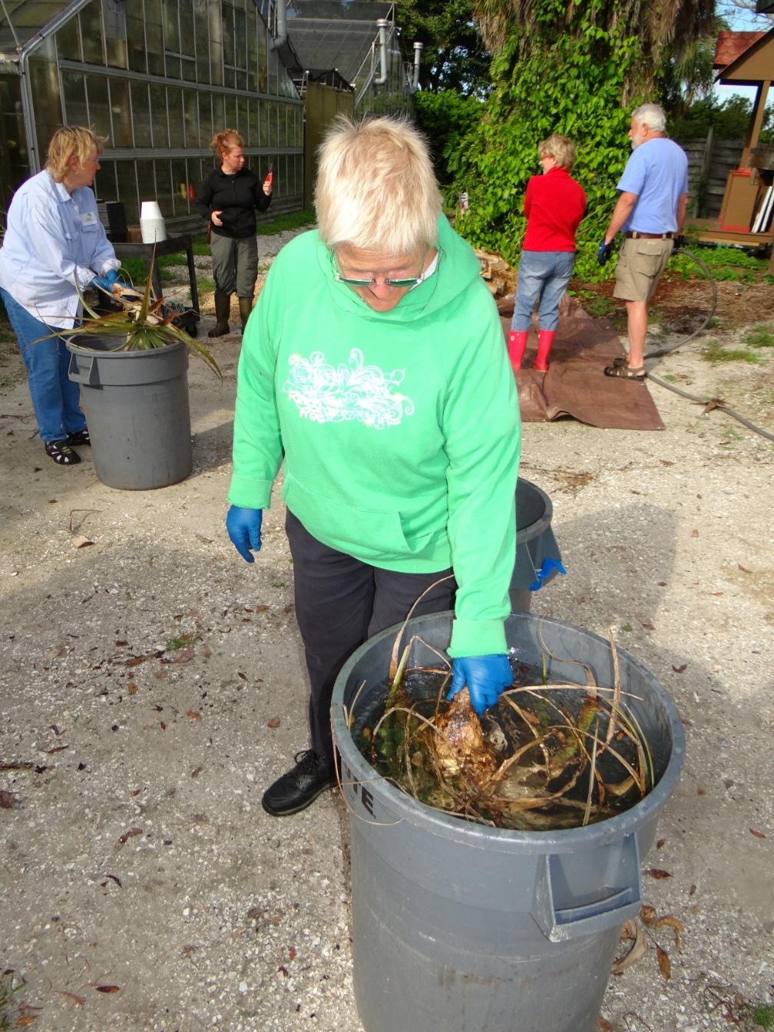

Slide 8
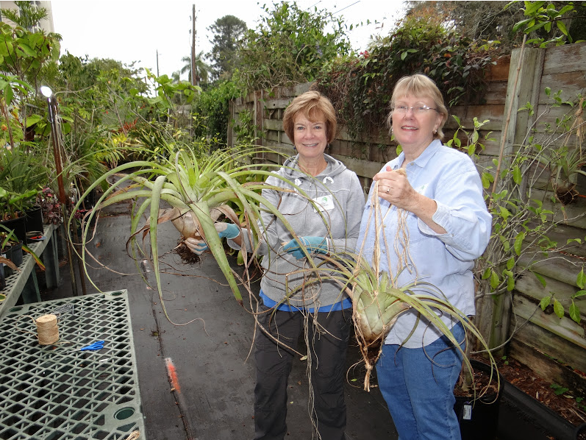
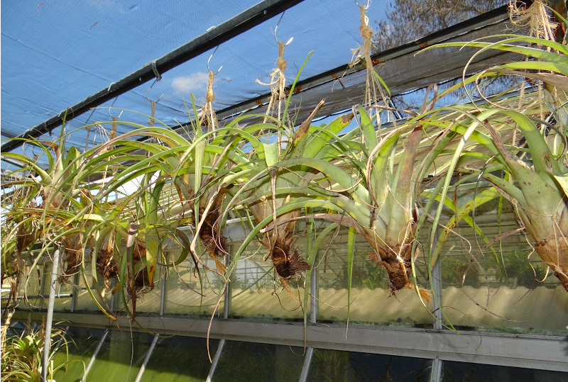

Slide 9
First Outplanting: November 13, 2014

Slide 11
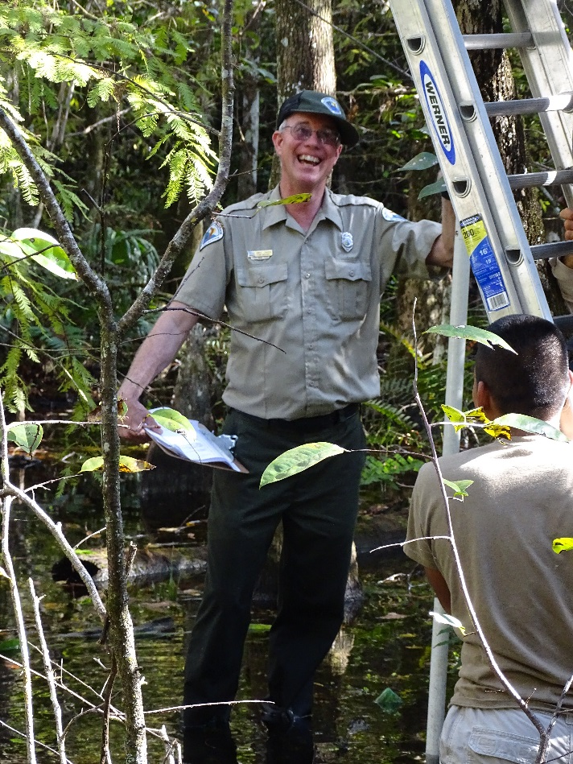
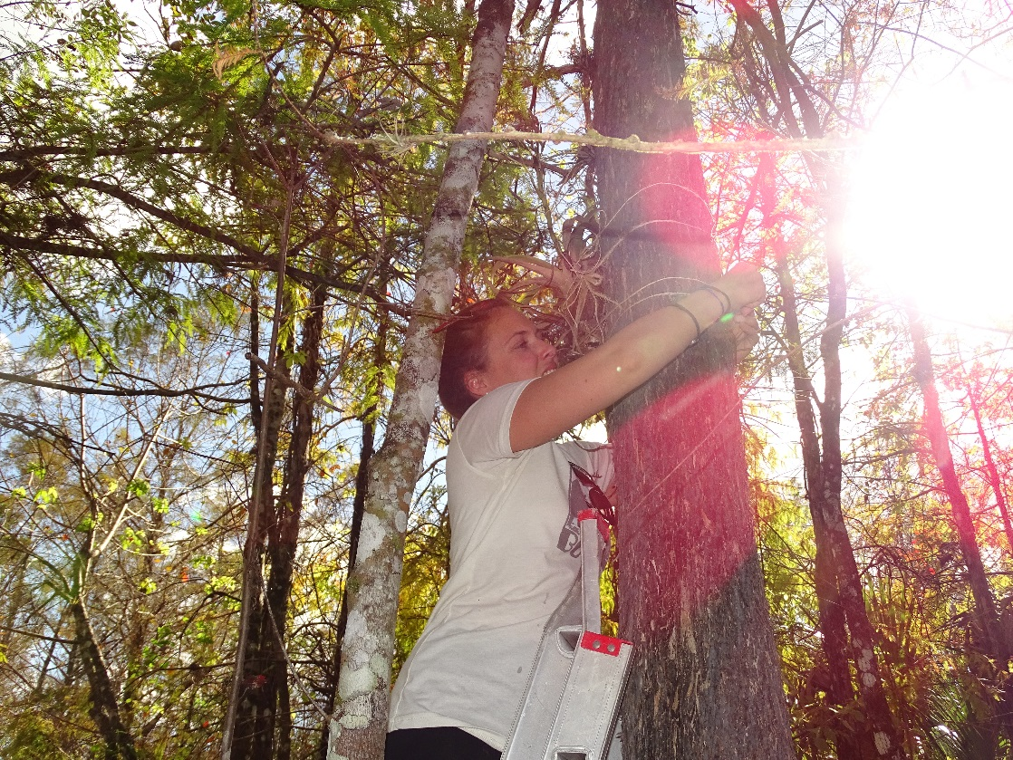
14 Plants Returned

Slide 12
First Inspection: March 24, 2015

Slide 14
Second Outplanting: Nov. 20, 2015
50 Plants Returned

Slide 16
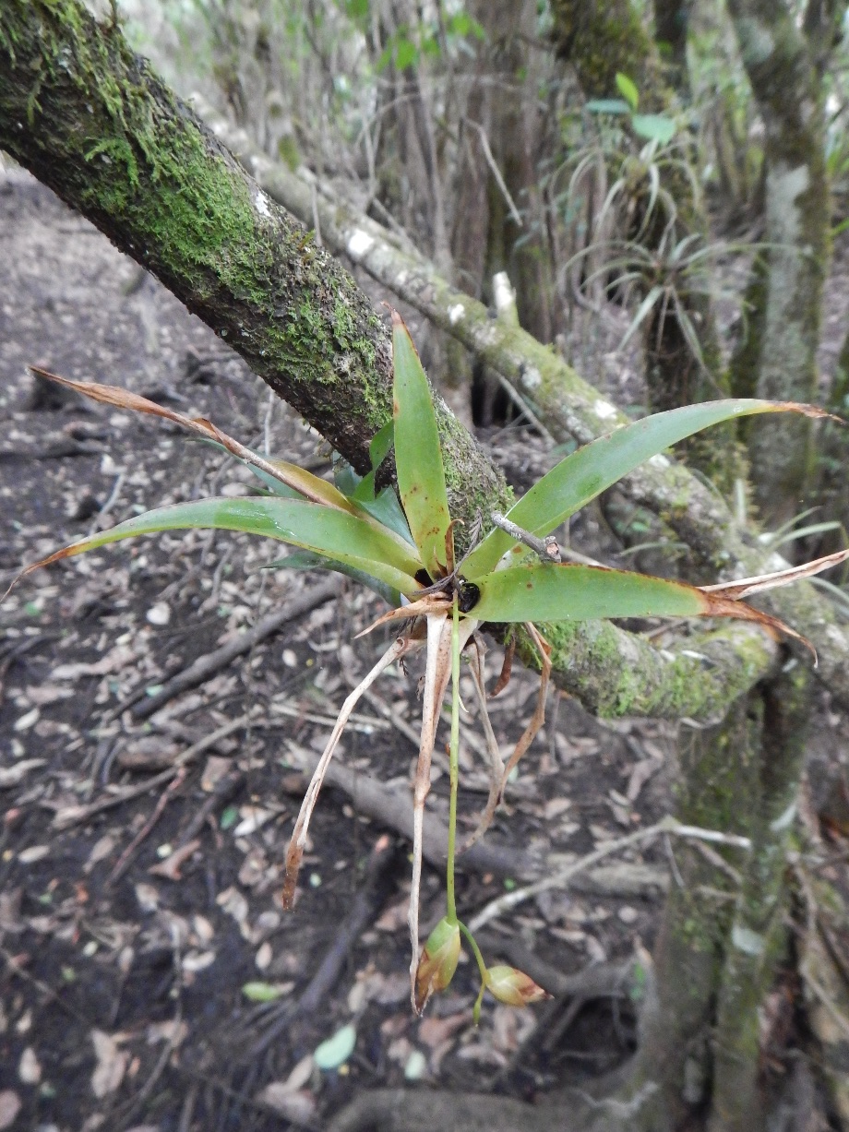
Other Genera: Catopsis

Slide 17
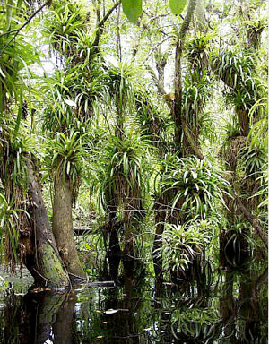
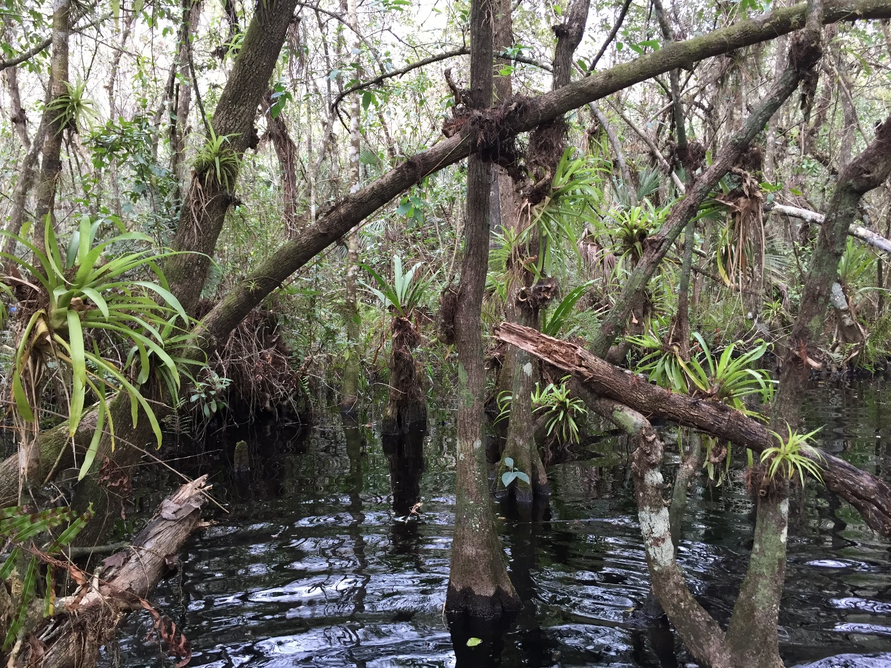
Other Genera: Guzmania
Photo: Shirley Denton

Slide 21
Seedling Photography

Slide 22
Tillandsia utriculata: April 20, 2015

Slide 23
Tillandsia utriculata: June 1, 2015

Slide 24
Tillandsia utriculata: June 25, 2015

Slide 25
Tillandsia utriculata: July 2, 2015

Slide 26
Tillandsia utriculata: August 27, 2015

Slide 27
Tillandsia utriculata: Sept. 21, 2015

Slide 28
Tillandsia utriculata: Oct. 26, 2015

Slide 29
Tillandsia utriculata: Nov. 23, 2015

Slide 30
Tillandsia bartramii

Slide 31
Tillandsia setacea

Slide 33
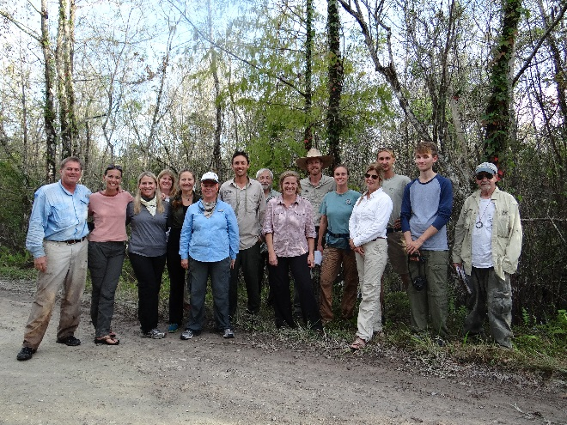
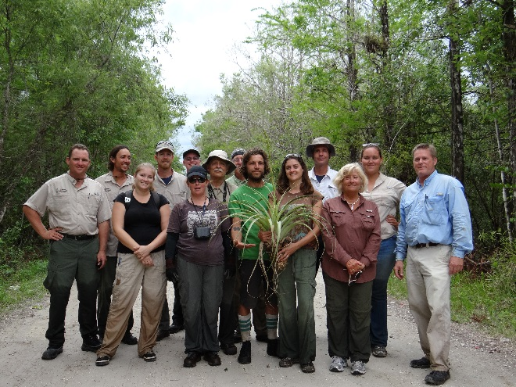
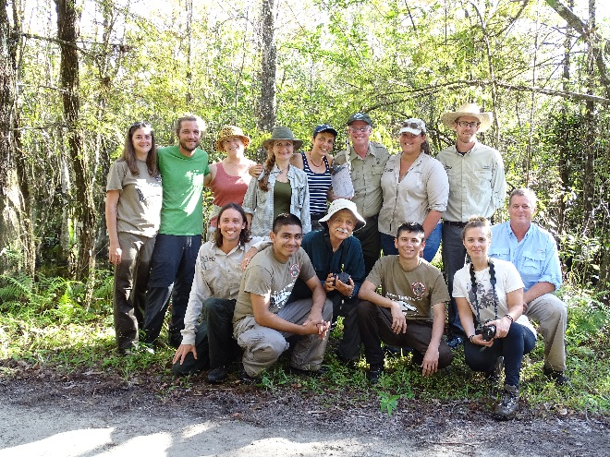
Acknowledgments
Carol and Virginia Miller
Wade Collier and David Troxell
Mike Owen and Fakahatchee Staff and Volunteers
Teresa Cooper, UF
Selby Gardens Botany, Education, and Hort. Staff
Naples Botanical Garden
Caves Branch Botanical Garden, Belize

